Slide 1
Integrating Computer Vision Software in Native Mobile Apps
Written in Angular
Liviu Alexandru Bobocu, Software DEveloper

Slide 2
agenda
MACHINE LEARNING AND IOT
ONE APPLICATION, MULTIPLE DEVICES
NATIVE, But with A Script
THE SCHEME IN SCHEMAtics
USING FIREBASE
Further READINGS

Slide 3
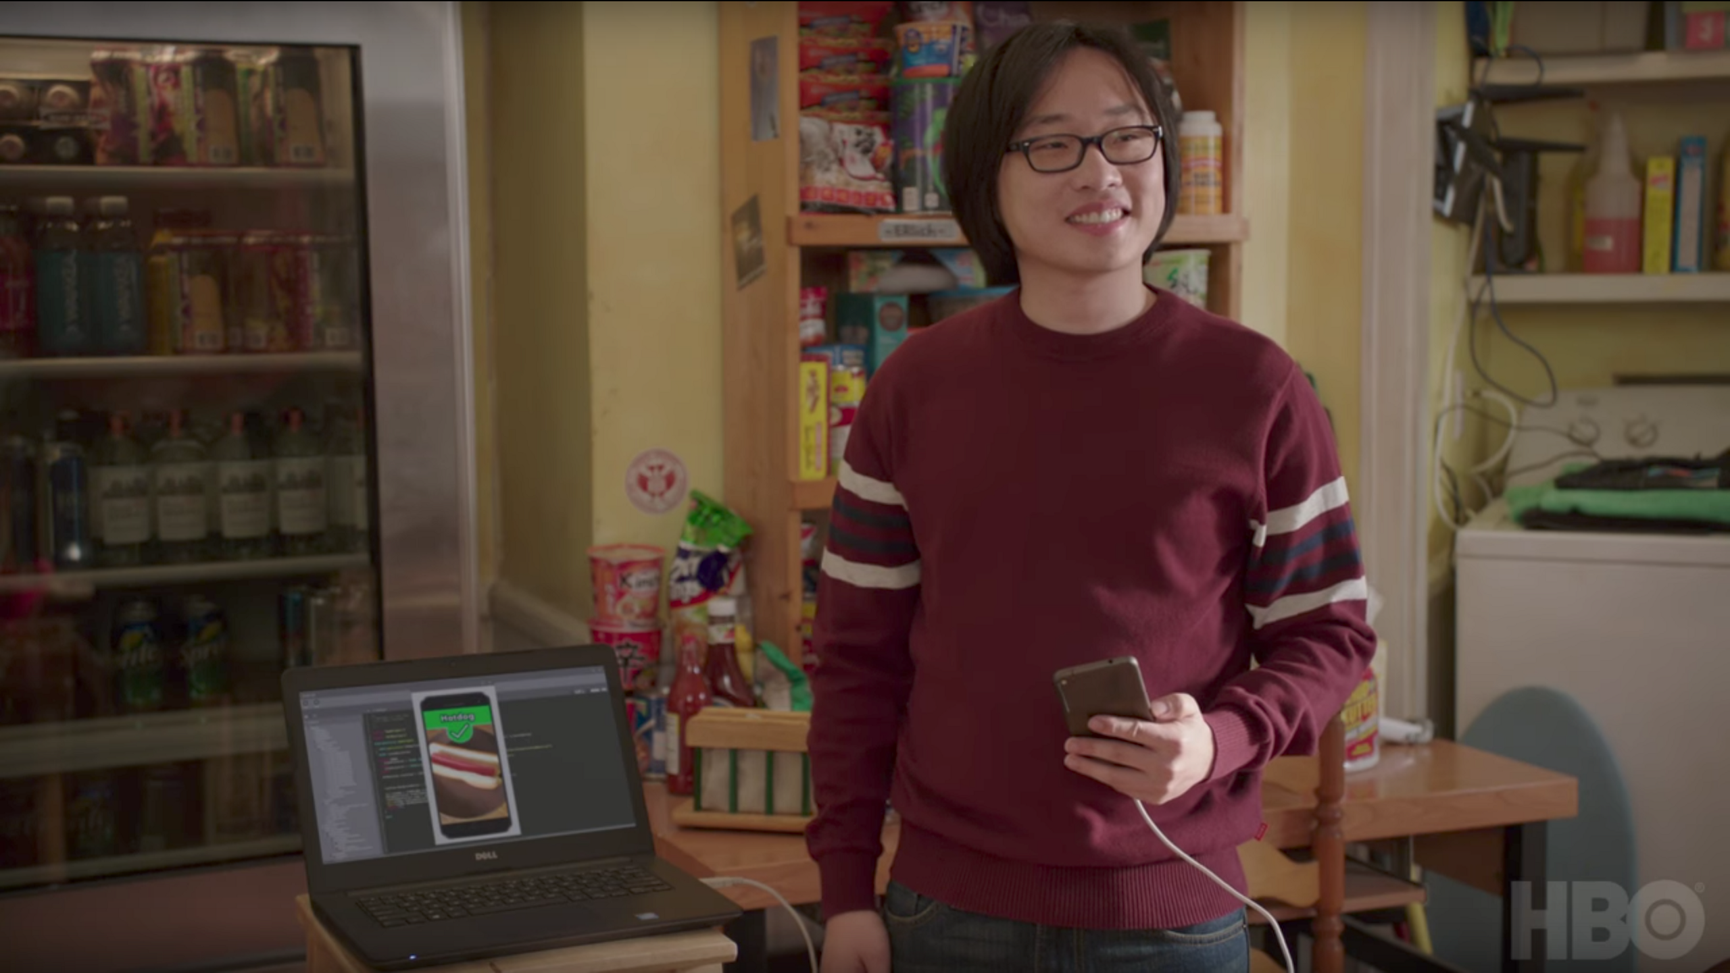
MACHINE LEARNING AND IOT

Slide 4
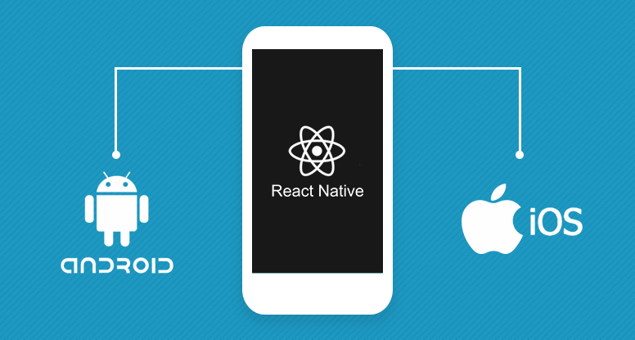

MACHINE LEARNING AND IOT
NOT A HOTDOG APP
Check out the git repo -> https://github.com/shaqian/Not-Hotdog

Slide 5





MACHINE LEARNING AND IOT
What is TensorFlow?
A machine learning framework among many others

Slide 6

MACHINE LEARNING AND IOT
We need to take a decision

Slide 7




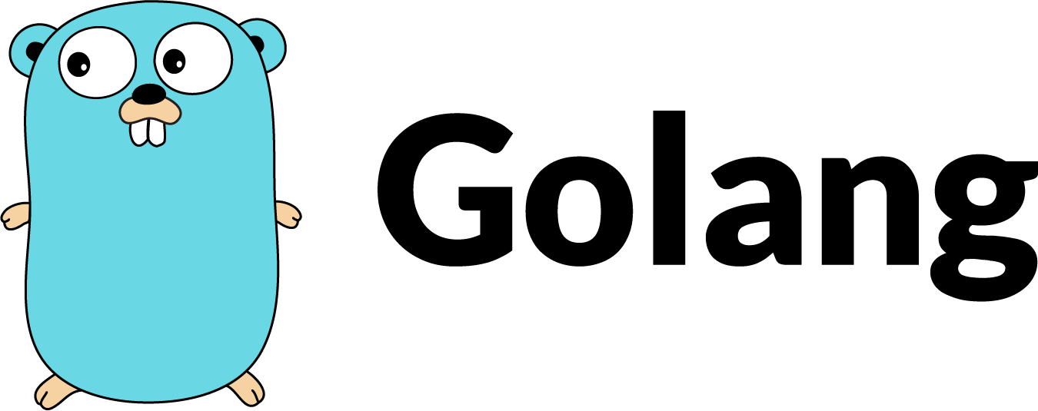
MACHINE LEARNING AND IOT
Tensorflow Language Support
Choose the language in which to write your classifier

Slide 8
MACHINE LEARNING AND IOT
Tensorflow wins for IOT

Slide 9
agenda
MACHINE LEARNING AND IOT
ONE APPLICATION, MULTIPLE DEVICES
NATIVE, But with A Script
THE SCHEME IN SCHEMAtics
USING FIREBASE AND TENSORFLOW LITE
Further READINGS

Slide 10

ONE SHARED APPLICATION, MULTIPLE DEVICES
Take a decision again

Slide 11


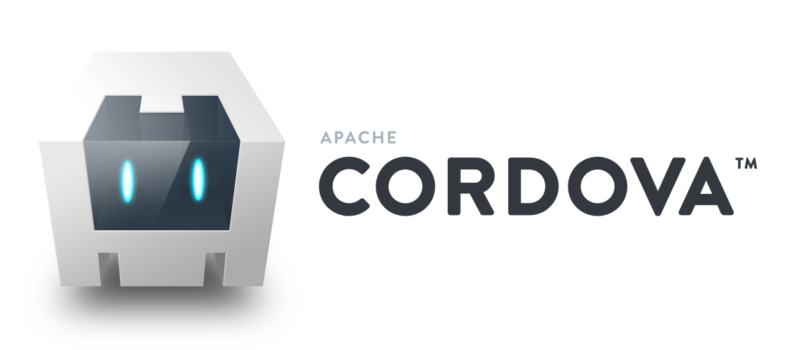




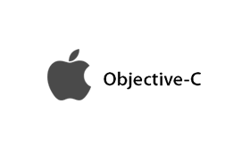
ONE SHARED APPLICATION, MULTIPLE DEVICES
Native Native with scripting WEB VIEW

Slide 12
ONE SHARED APPLICATION, MULTIPLE DEVICES
SAME CODEBASE FOR WEB AND MOBILE (IOS AND ANDROID)
Code | Native Android | Native iOS | Web
Components | Shared | Shared | Shared
Services | Shared | Shared | Shared
Libraries | Shared | Shared | Shared
Backend | Shared | Shared | Shared
Modules and Routing | Same for Android and iOS | Same for Android and iOS | Different
Component Templates(HTML and XML) | Different | Different | Different
By using NativeScript in a shared web/mobile application you can achieve up to 70 - 80% code reusability between environments.

Slide 13
agenda
MACHINE LEARNING AND IOT
ONE APPLICATION, MULTIPLE DEVICES
NATIVE, But with A Script
THE SCHEME IN SCHEMAtics
USING FIREBASE
Further READINGS

Slide 14

NATIVE, BUT WITH A SCRIPT
Who makes this possible

Slide 15
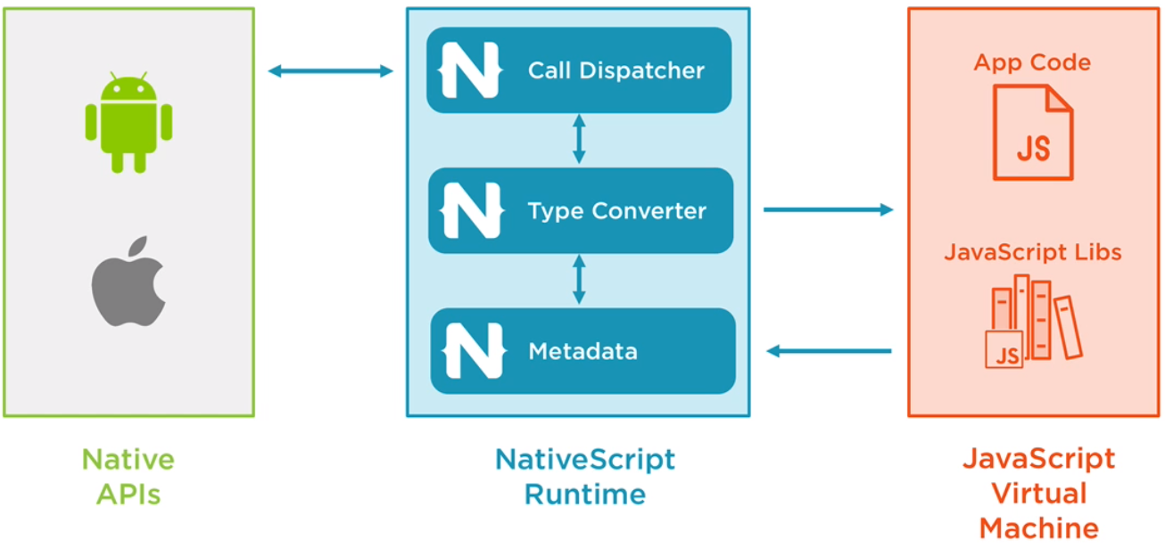
NATIVE, BUT WITH A SCRIPT
THE RUNTIME

Slide 16
NATIVE, BUT WITH A SCRIPT
THE NATIVESCRIPT CLI
Use either
nativescript <command> or
tns <command>
Usual commands:
>tns create
>tns platform
>tns install
>tns run
>tns debug
>tns livesync

Slide 17
agenda
WHAT’S THE STORY?
WHY NATIVE?
ONE APPLICATION, MULTIPLE DEVICES
NATIVE, But with A Script
THE SCHEME IN SCHEMAtics
USING FIREBASE
Further READINGS

Slide 18
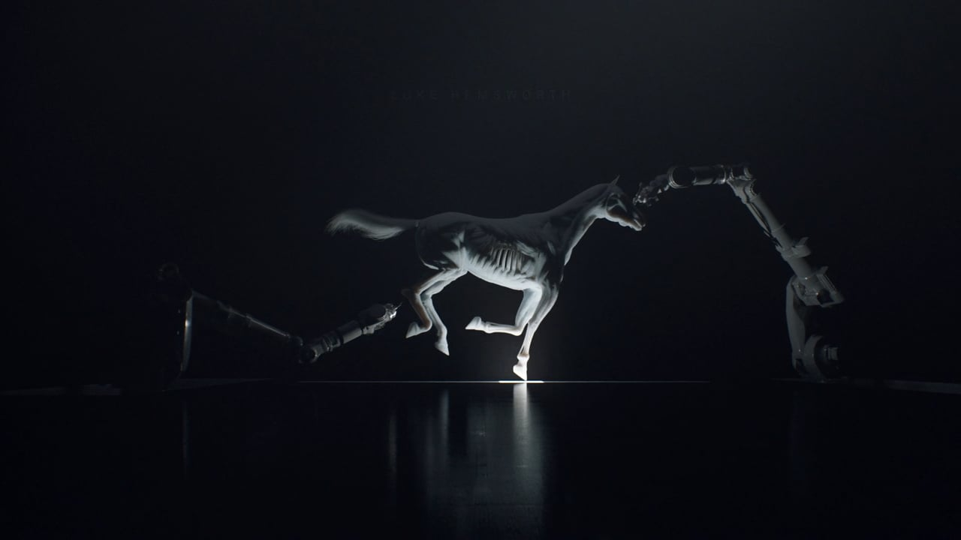
THE SCHEME IN SCHEMATICS
The Tool that helps Angular to bring Native to Life

Slide 19
THE SCHEME IN SCHEMATICS
CREATING AN ANGULAR APP WITH NATIVESCRIPT
NativeScript only
ng new --collection=@nativescript/schematics my-mobile-app
NativeScript shared web and mobile
ng new --collection=@nativescript/schematics my-shared-app --shared

Slide 20
THE SCHEME IN SCHEMATICS
Having the same codebase
You can have the same codebase:
using modules with different extensions (.ts and .tns.ts) + achiving routing for each type of module.
Using templates with different extensions (.html and .tns.html)
For all others Components, Services, libraries and backend), everything remains the same

Slide 21
agenda
WHAT’S THE STORY?
WHY NATIVE?
ONE APPLICATION, MULTIPLE DEVICES
NATIVE, But with A Script
THE SCHEME IN SCHEMAtics
USING FIREBASE
Further READINGS

Slide 22



USING FIREBASE
A WEB Framework in The GOOGLE ECOSYSTEM

Slide 23
FIREBASE
A WEB Framework in The GOOGLE ECOSYSTEM
Provides fully fledged backend solutions
Provides databases
Provides hosting
Provides serverless solutions
Integrates awesomely with Angular, Google Cloud, and Tensorflow.

Slide 24
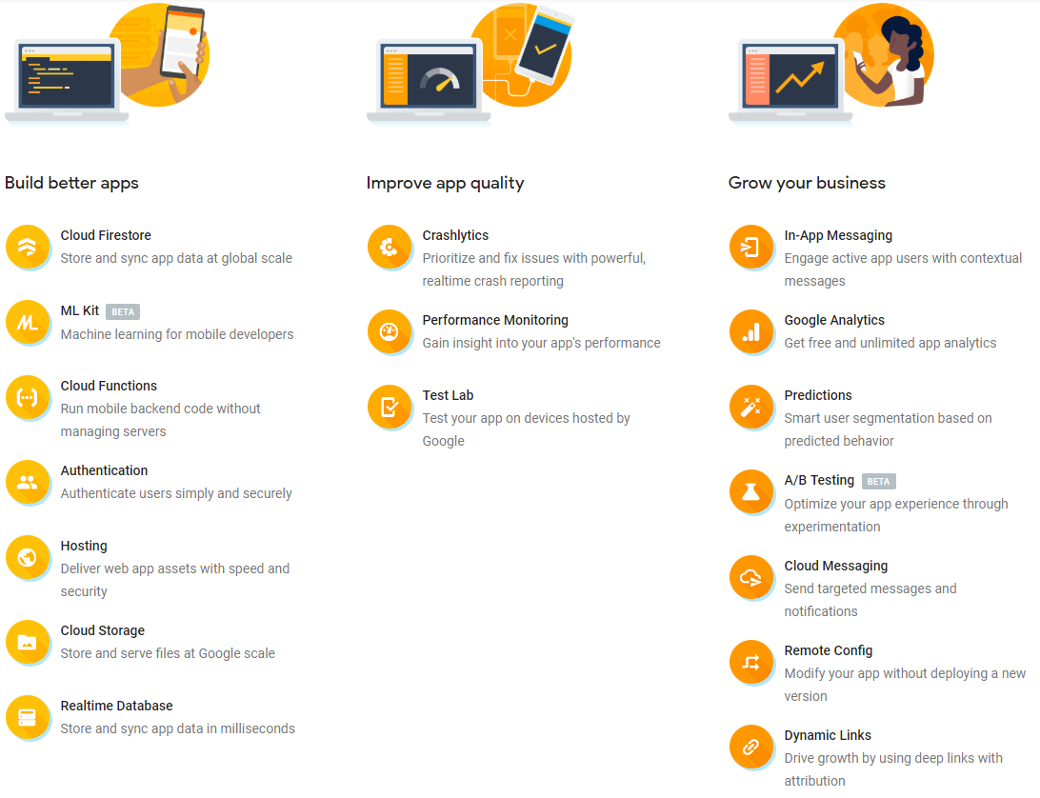
FIREBASE
We’re going to use this!

Slide 25
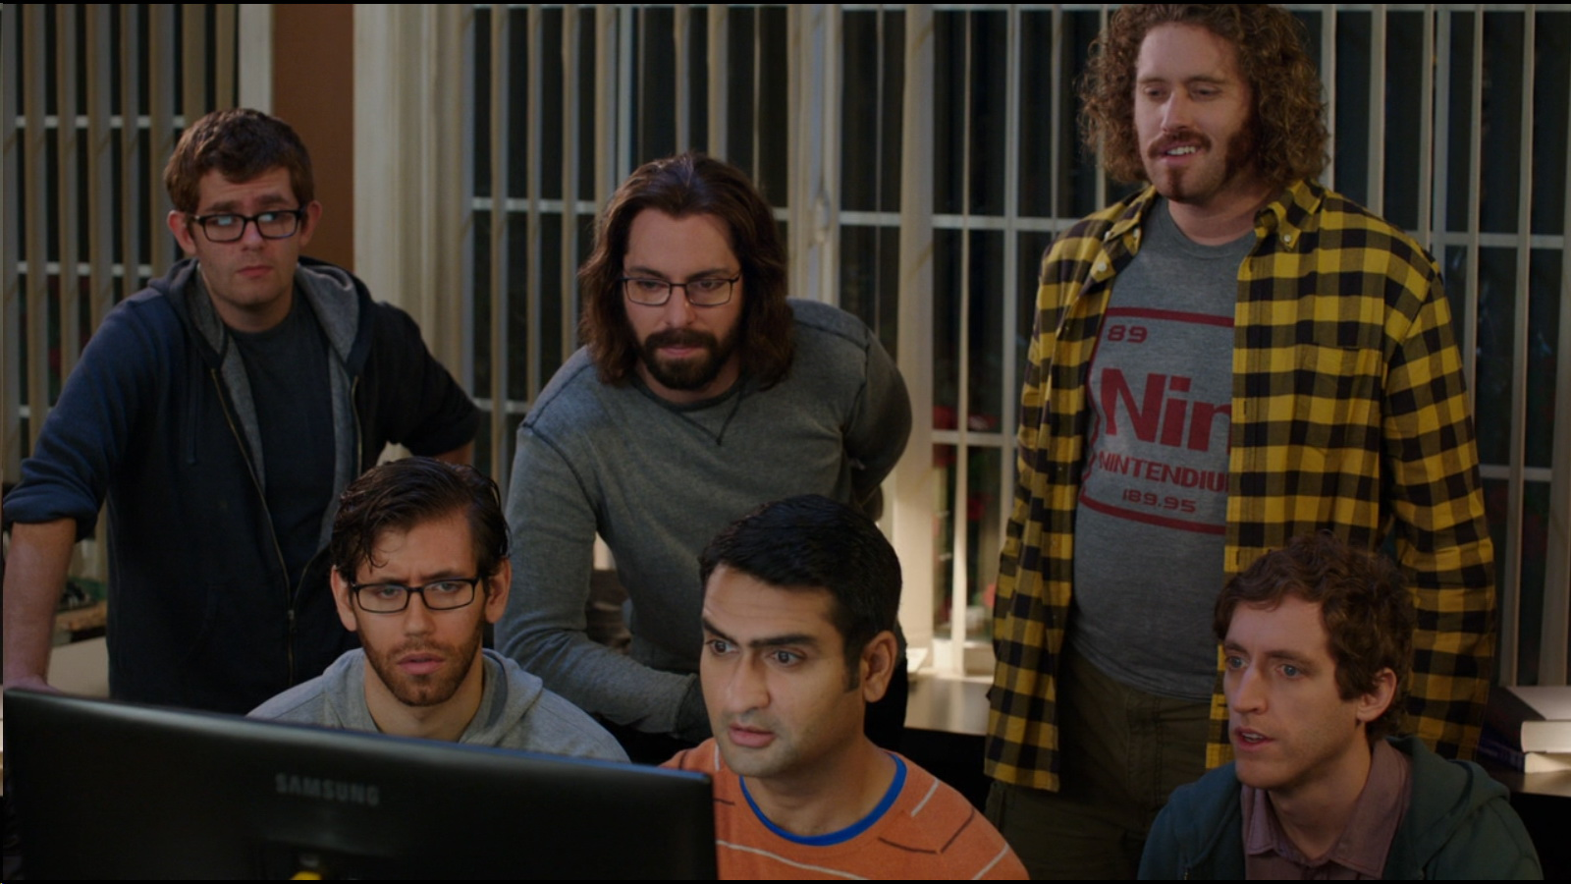
FIREBASE
Links in handy
Firebase ML Kit
https://firebase.google.com/docs/ml-kit/
Firebase NativeScript Wrapper
https://github.com/EddyVerbruggen/nativescript-plugin-firebase
Firebase NativeScript ML Kit Wrapper
https://github.com/EddyVerbruggen/nativescript-plugin-firebase/blob/master/docs/ML_KIT.md

Slide 26
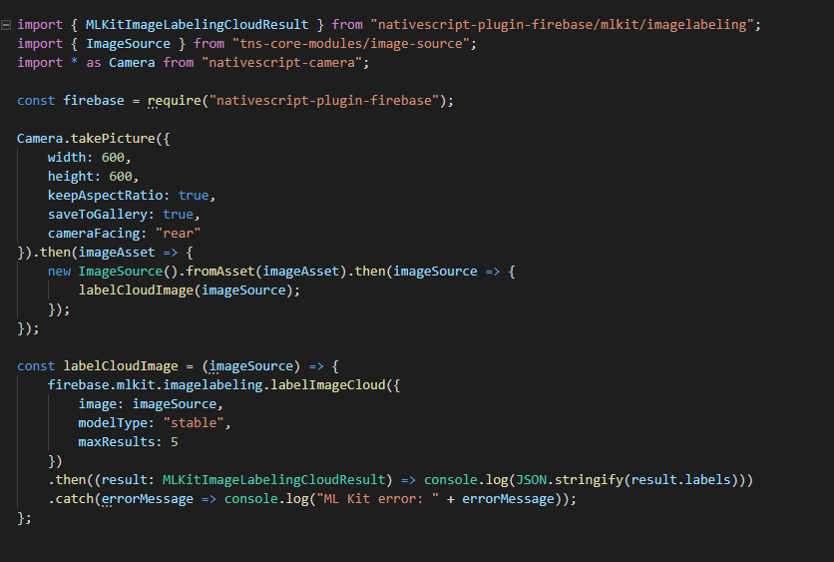
FIREBASE CLOUD LABELLING
1. Import dependencies.
2. We use the nativescript camera to take a picture with our mobile phone.
3. We use the image asset resulted from using our mobile camera and create an image source from it.
4. We use our firebase classifier to label the image source resulted from using our camera and then process the results.

Slide 27
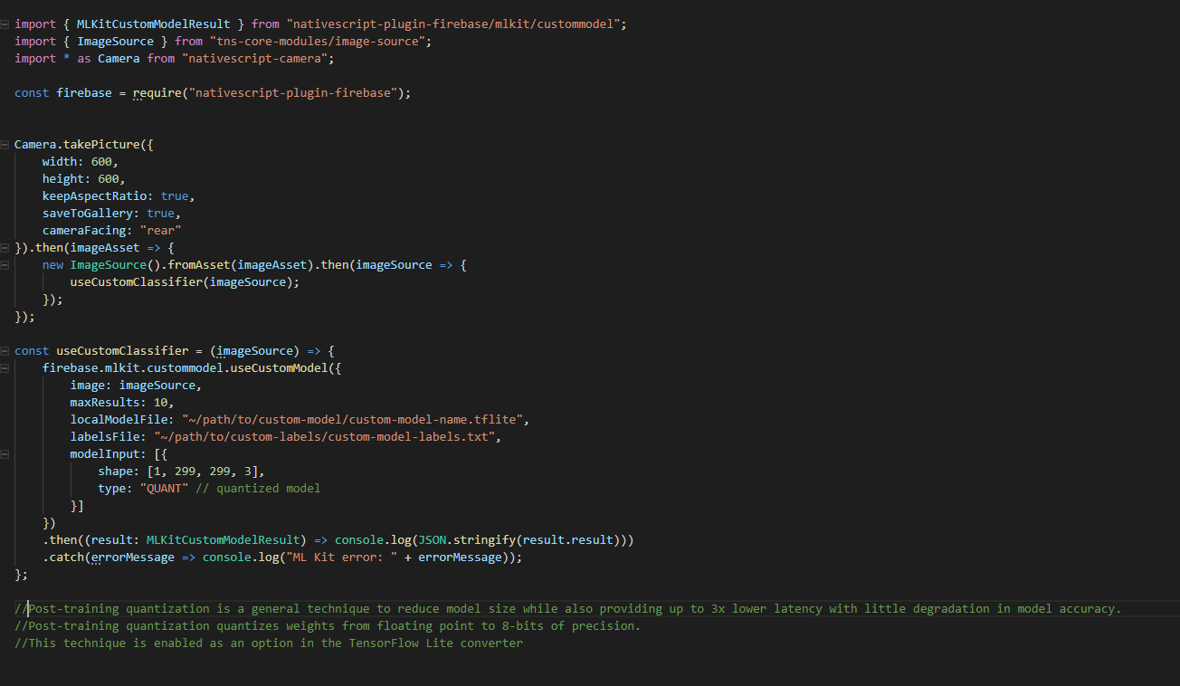
FIREBASE USING CUSTOM CLASSIFIER
1. Import dependencies.
2. We use the nativescript camera to take a picture with our mobile phone.
3. We use the image asset resulted from using our mobile camera and create an image source from it.
4. We use our firebase custom trained classifier and our custom labels in order to label our image

Slide 28
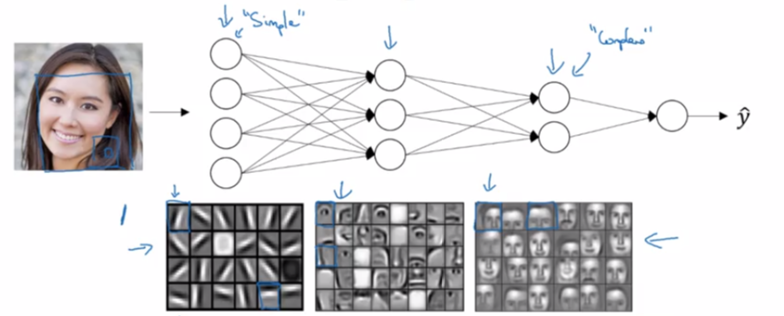

Intuition about DEEP NETWORKS
Strengthen your machine learning knowledge on Coursera with Andrew Ng -> https://www.coursera.org/specializations/deep-learning

Slide 29
agenda
WHAT’S THE STORY?
WHY NATIVE?
ONE APPLICATION, MULTIPLE DEVICES
NATIVE, But with A Script
THE SCHEME IN SCHEMAtics
USING FIREBASE
Further READINGS

Slide 30
Further Readings
Docs and Application Link
Angular Documentation:
https://angular.io/docs
NativeScript Documentation
https://docs.nativescript.org/
Angular Integration with NativeScript
https://www.nativescript.org/angular-mobile-landing-page
Endava ML APP:
https://github.com/liviualexandrubobocu/endava-ml-app
Firebase ML Kit
https://firebase.google.com/docs/ml-kit/
Firebase NativeScript Wrapper
https://github.com/EddyVerbruggen/nativescript-plugin-firebase
Firebase NativeScript ML Kit Wrapper
https://github.com/EddyVerbruggen/nativescript-plugin-firebase/blob/master/docs/ML_KIT.md

Slide 31

THANK YOU

